Slide 1
SRI LANKA ECONOMY CURRENT STATUS VISUALIZATION
18880056

Slide 2
INTRODUCTION
The main economic sectors of the country are tourism, tea export, apparel, textile, rice production and other agricultural products.
In addition to these economic sectors, overseas employment contributes highly in foreign exchange, 90% of expatriate Sri Lankans reside in the Middle East.

Slide 3
INTRODUCTION
What has been happening in Sri Lanka?
People have been struggling with daily power cuts and shortages of basics such as fuel, food and medicines.
Inflation is running at more than 50%.
The country doesn't have enough fuel for essential services like buses, trains and medical vehicles, and officials say it doesn't have enough foreign currency to import more.
What happens when a country runs out of money?
Sri Lanka is unable to buy the goods it needs from abroad.
And in May it failed to make an interest payment on its foreign debt for the first time in its history.

Slide 4
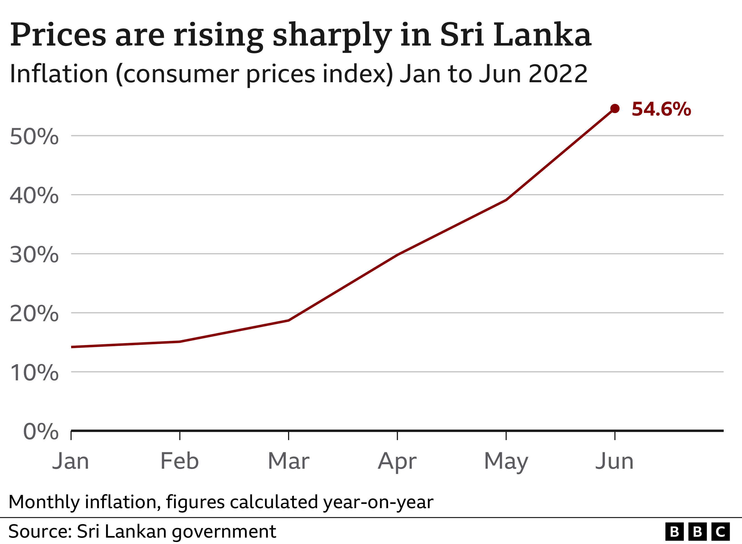

Slide 5
WHAT LED TO THE ECONOMIC CRISIS?
The government blamed the Covid pandemic, which badly affected Sri Lanka's tourist trade - one of its biggest foreign currency earners.
It also says tourists were frightened off by a series of deadly bomb attacks in 2019.
However, many experts blame President Rajapaksa's poor economic mismanagement.

Slide 6
LET’S ANALYSE …

Slide 7
DATASET
This dataset contains of 62 records from 1960-2021
Exports/Imports
Foreign Direct Investment
Inflation Rate
Unemployment
Manufacturing Output
Economic Growth
Data extracted from URL: https://www.macrotrends.net/countries/LKA/sri-lanka/
There are so many null values in this dataset.

Slide 8
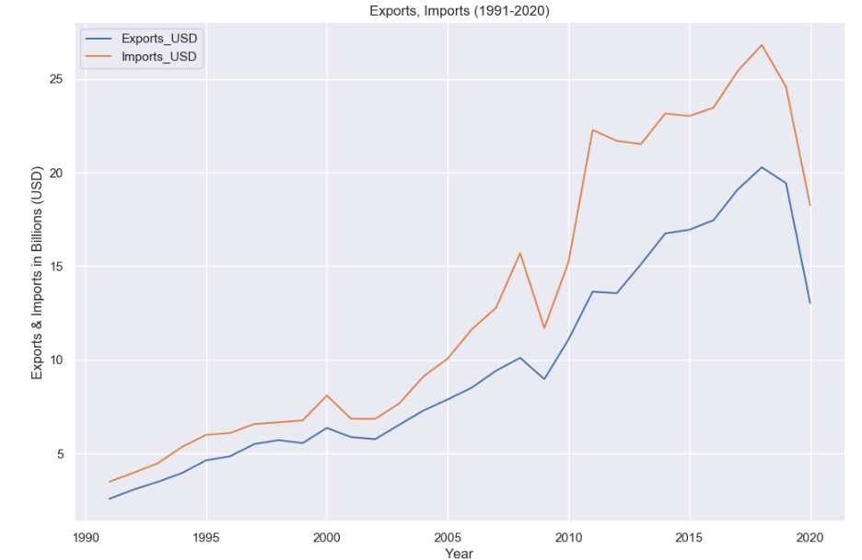
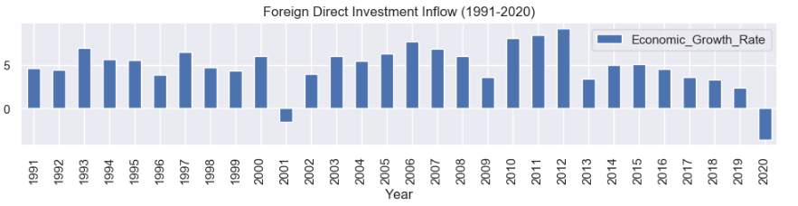
EXPORT & IMPORTS WITH ECONOMIC GRWOTH
Sri Lanka exports for 2020 was $13.03B, a 32.92% decline from 2019.
Exports for 2019 was $19.43B, a 4.14% decline from 2018.
Exports for 2018 was $20.27B, a 6.17% increase from 2017.
Sri Lanka imports for 2021 was $21.39B, a 17.27% increase from 2020.
Imports for 2020 was $18.24B, a 25.78% decline from 2019.
Imports for 2019 was $24.57B, a 8.33% decline from 2018.

Slide 9
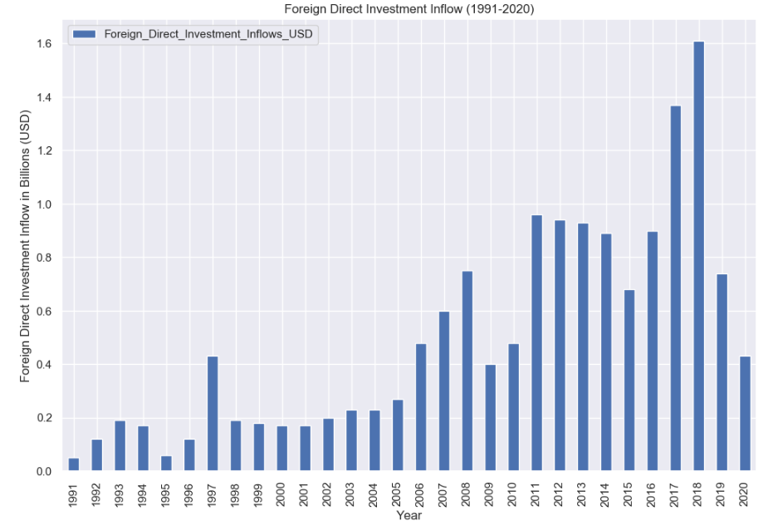
FOREIGN DIRECT INVESTMENT INFLOW
Sri Lanka foreign direct investment for 2020 was $0.43B, a 41.64% decline from 2019.
Foreign direct investment for 2019 was $0.74B, a 53.94% decline from 2018.
Foreign direct investment for 2018 was $1.61B, a 17.58% increase from 2017.
Foreign direct investment for 2017 was $1.37B, a 53.03% increase from 2016

Slide 10
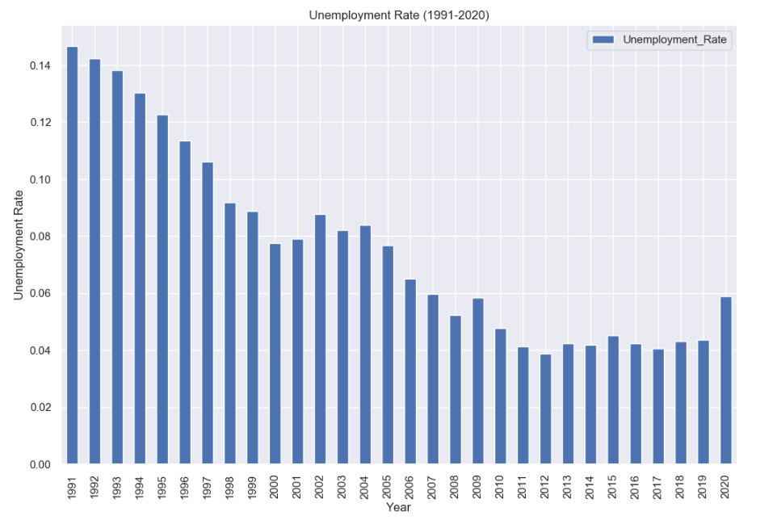
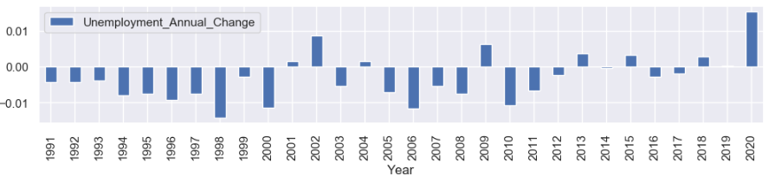
UNEMPLOYMENT RATE
Sri Lanka unemployment rate for 2021 was 5.40%, a 0.48% decline from 2020.
Sri Lanka unemployment rate for 2020 was 5.88%, a 1.53% increase from 2019.
Sri Lanka unemployment rate for 2019 was 4.35%, a 0.03% increase from 2018.

Slide 11
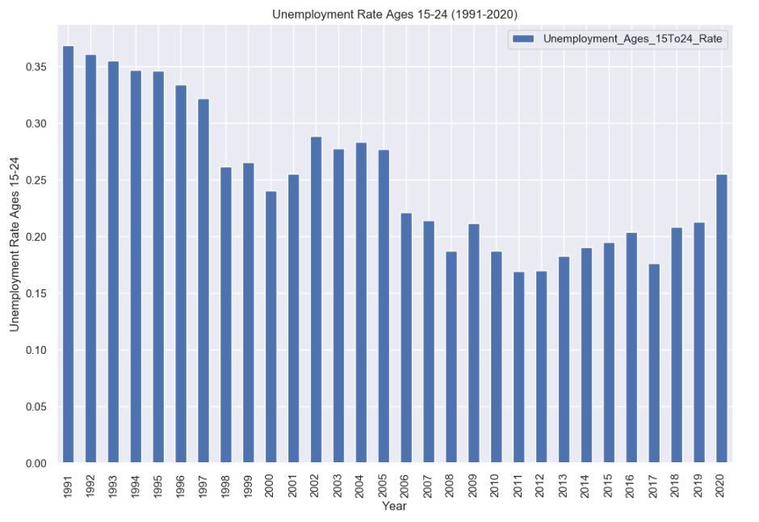
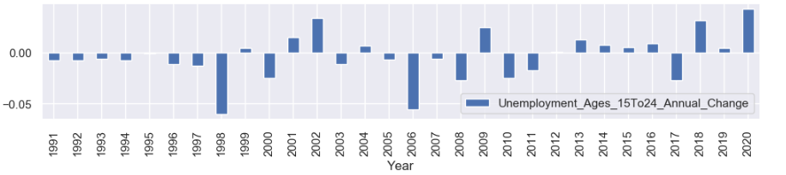
UNEMPLOYMENT RATE AGES 15-24
Sri Lanka youth unemployment rate for 2021 was 26.06%, a 0.52% increase from 2020.
Sri Lanka youth unemployment rate for 2020 was 25.53%, a 4.27% increase from 2019.
Sri Lanka youth unemployment rate for 2019 was 21.26%, a 0.44% increase from 2018.
Sri Lanka youth unemployment rate for 2018 was 20.82%, a 3.16% increase from 2017

Slide 12
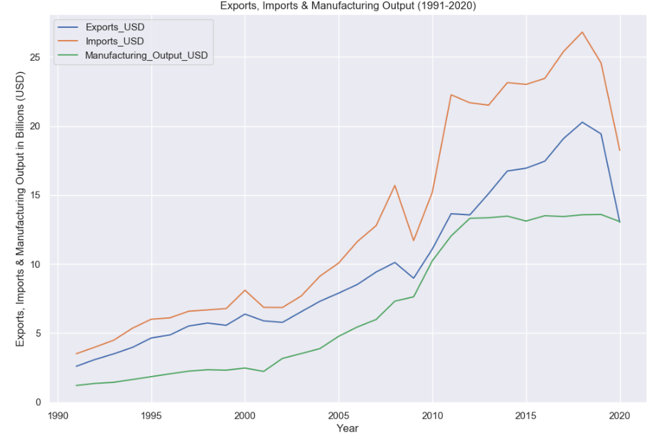
IMPORTS VS EXPORTS VS MANUFACTURING OUTPUT
Sri Lanka manufacturing output for 2021 was $15.20B, a 16.27% increase from 2020.
Sri Lanka manufacturing output for 2020 was $13.07B, a 3.8% decline from 2019.
Sri Lanka manufacturing output for 2019 was $13.59B, a 0.12% increase from 2018.
Sri Lanka manufacturing output for 2018 was $13.57B, a 1% increase from 2017.

Slide 13
CONCLUSION
At the end of its civil war in 2009, Sri Lanka chose to focus on providing goods to its domestic market, instead of trying to boost foreign trade.
This meant its income from exports to other countries remained low, while the bill for imports kept growing.
Sri Lanka now imports $3bn (£2.3bn) more than it exports every year, and that is why it has run out of foreign currency.
At the end of 2019, Sri Lanka had $7.6bn (£5.8bn) in foreign currency reserves, which have dropped to around $250m (£210m).

Slide 14
THANK YOU

